Slide 1

Seattle Home Price Predictions
Created & Presented by:
Siege, Lee, Sravani, Roman

Slide 2


The Team
The Team™

Slide 3
Project Intent
Determine Predictability of Median Sales Prices Through Our Dataset
H0 = Cannot be predicted
H1 = Can be predicted

Slide 4
Measurements & Metrics
REDFIN Dataset
Median Sales Price
Number of Home Sales
Inventory
New Listings
Days on Market
Average Sale to List

Slide 5
Models
All of them.
Explored the following models:
ARMA
ARIMA
GARCH
LSTM
Linear Regression
Etc. etc.

Slide 6
Exploration & Cleanup
CSV Data Imported
Multi-indexing
Ffill (pad method)
Removed special characters
String split of neighborhoods
Separating datasets
Drop null values

Slide 7
Difficulties Preparing Data
The Tedious Work
Getting multi-index to behave
Slicing multi-index data frame
Reshaping for various models
Some special character removals
Effectively assigning data types

Slide 8
Overall Training Process
Preparing Each Model
Reshaping & manipulating the data set
Calculating for only 2020 due to low granularity of data (monthly)
Neighborhood data split: 2020 – Test, 2012-2019 – Train
Eliminating data shuffle, due to using time series data

Slide 9
Overall Training Process
Model Flow
Split Data
Clean Data
Scale Data
Run Models

Slide 10
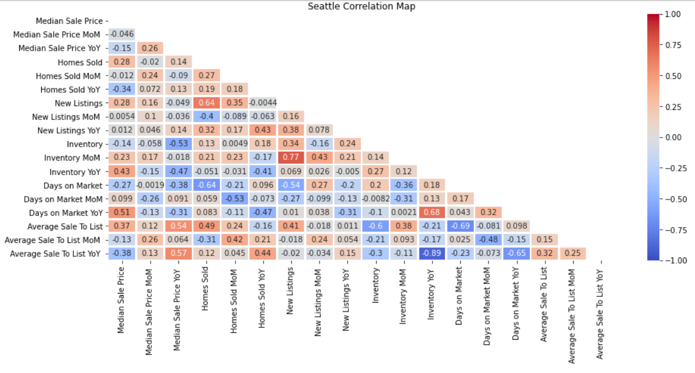
Model Evaluation
Seattle Data Only

Slide 11
Model Evaluation
LSTM
10 epochs
Batch size of 1
5-10 milliseconds per epoch
Nadam optimizer
Mean squared logarithmic error loss function
Multiple layers sampled
Sigmoid activation function added to output layer (0.0084 → 0.0057 results change)
ARMA / ARIMA / GARCH
Orders of (1, 1) ARMA & ARIMA
Order of (1, 1, 1) GARCH
Inconclusive results overall

Slide 12
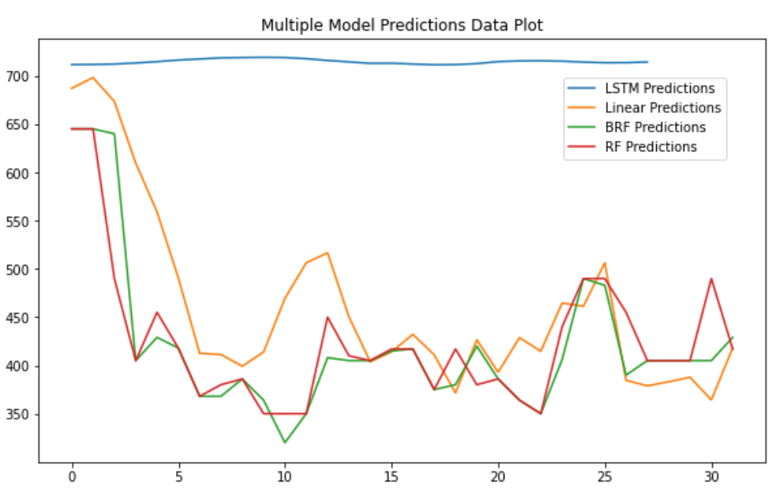
Model Evaluation
Seattle Data Only

Slide 13
The Neighborhoods
Low Volatility:
High Volatility:
Belltown
Broadway
International District
Pinehurst
Dunlap
Laurelhurst
Madison Park
Portage Bay
Seattle Central Business District
Denny Blaine

Slide 14
Features Importance
Low Volatility Most Important:
Average Sale Price to List Price
Inventory
High Volatility Most Important:
Average Sale Price to List Price
Days on Market

Slide 15
Features Importance
Low Volatility Least Important:
Homes Sold
Days on Market
High Volatility Least Important:
New Listings
Inventory

Slide 16
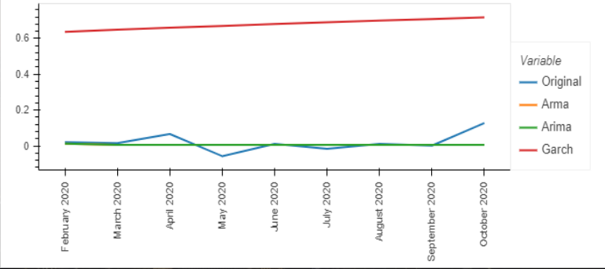
Model Evaluation
Low Volatility

Slide 17
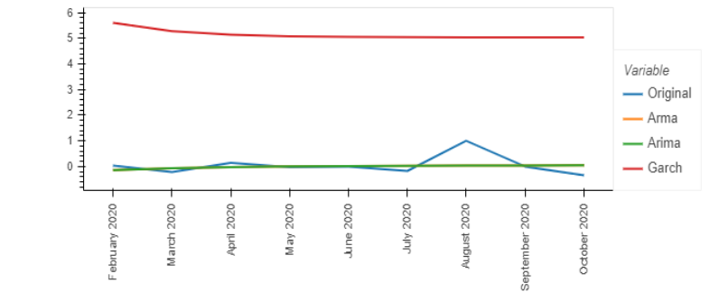
Model Evaluation
High Volatility

Slide 18
Postmortem
Difficulties:
Automating the calculations
Multi-indexing data frame
What we would look at with more time:
Average salaries per neighborhood
Population impact of prices
Search for and input more data for analysis
Additional models to evaluate

Slide 19
Questions?
Thank you!

Slide 20
Appendix

Slide 21
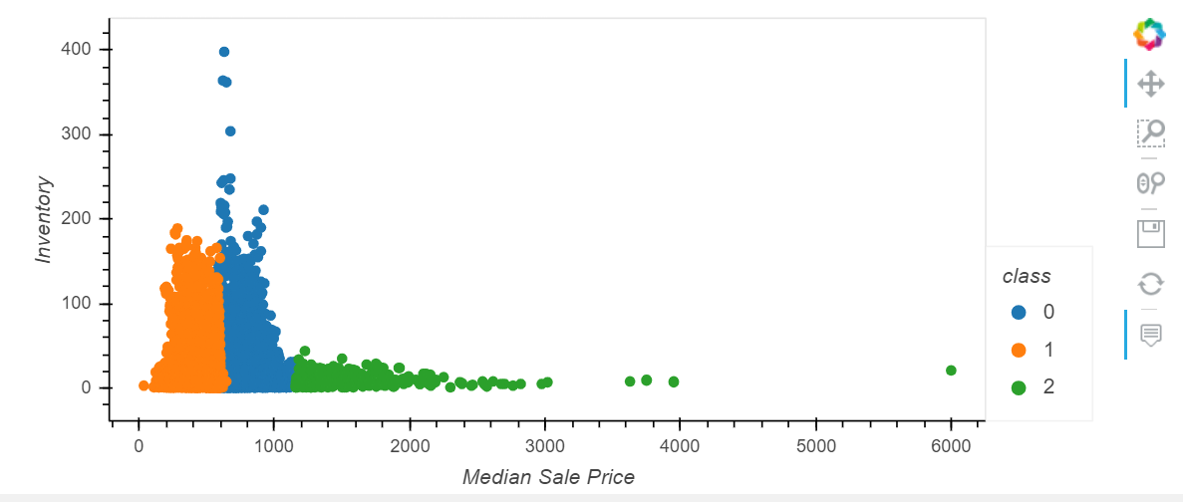
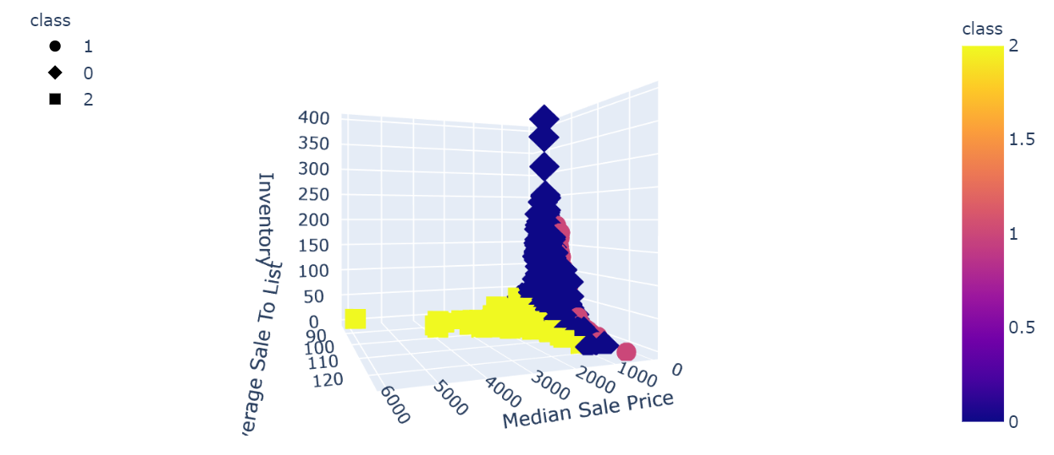
Neighborhood Clusters

Slide 22
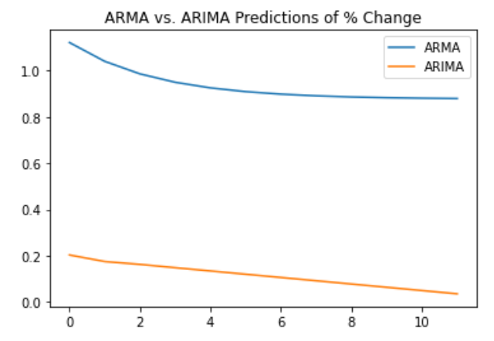
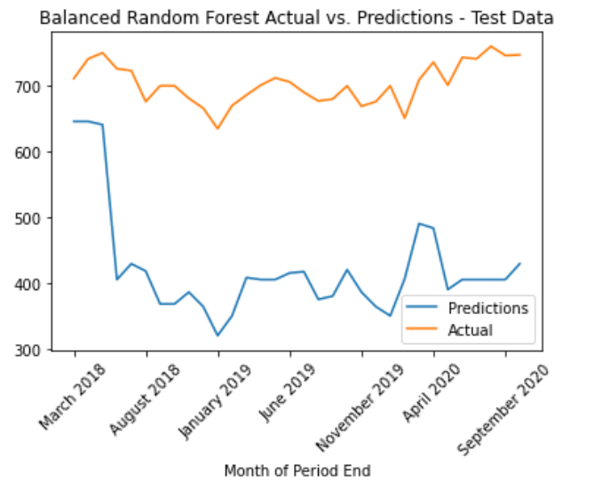
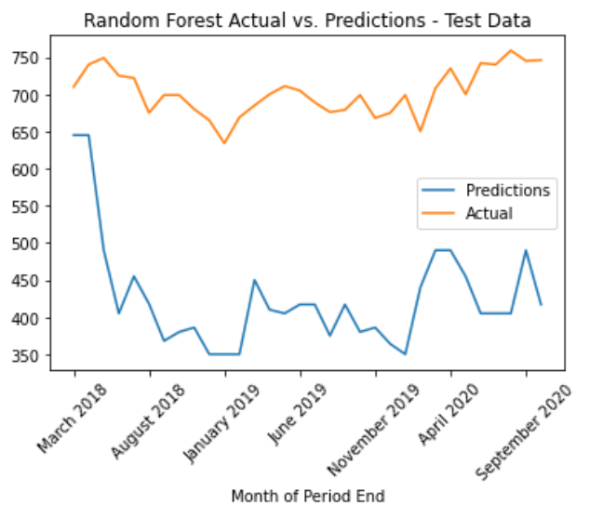
Seattle ARMA / ARIMA / BRF / RF

Slide 23
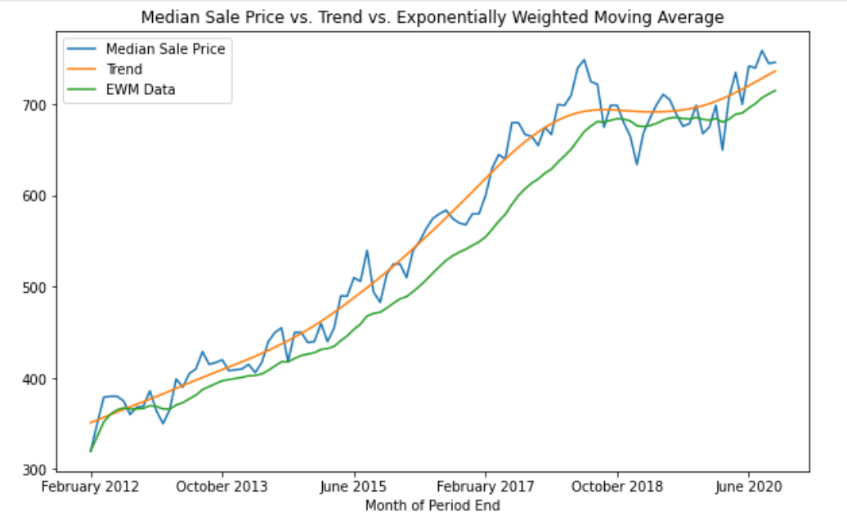
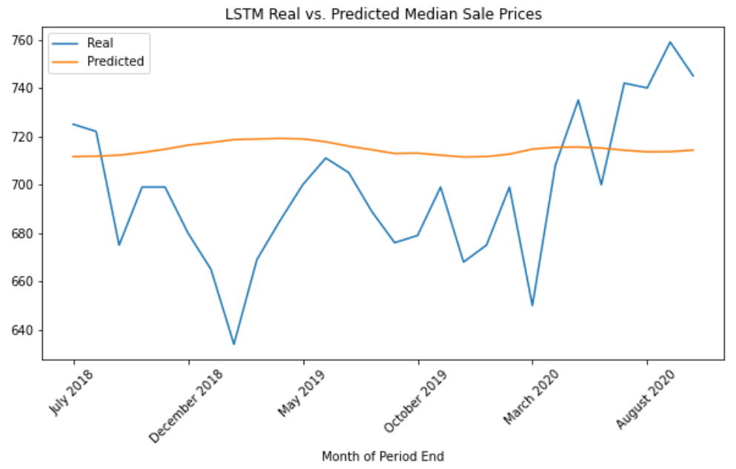
Seattle LSTM / EWMA / HP Filter

Slide 24
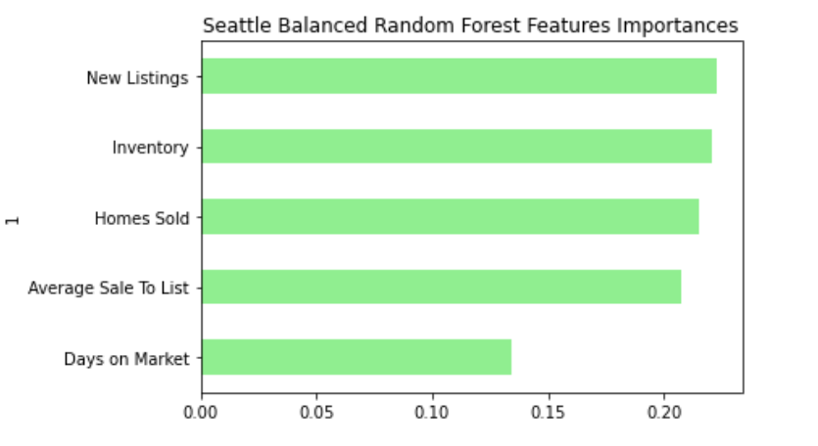
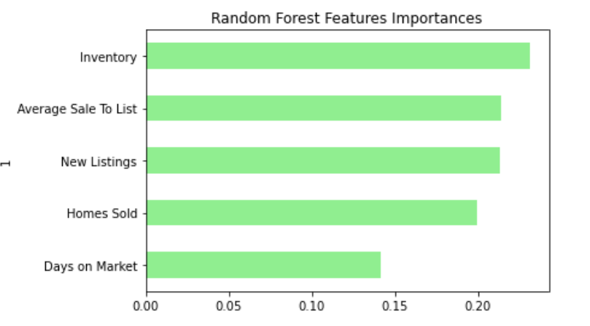
Seattle BRF / RF Features Importance

Slide 25
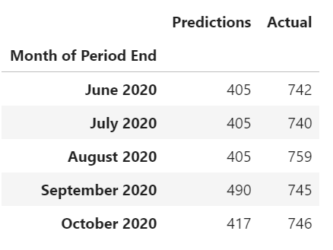
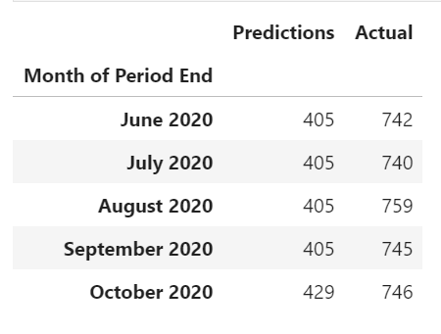
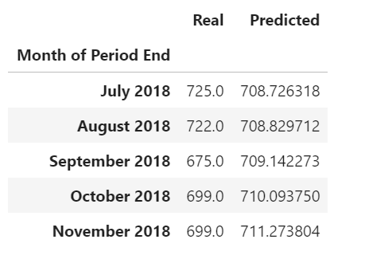
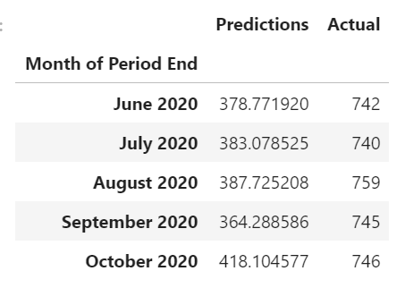
Random Forest
Balanced Random Forest
LSTM
Linear Regression

Slide 26
Appendix
What was our goal?
Data Exploration
FInd correlations
What did we learn?
Python/Pandas
Seattle Real Estate

